Slide 1

Diversity in Tech Carlos Ruiz, Paris Lee, Daniel Purrier, Neyda Morales June 10, 2024

Slide 2
Agenda
Introduction
Data Cleaning
Research Questions
Linear Modeling/Statistical Modeling
Call to Action
Bias and Limitations
Future Work
Works Cited
Q&A

Slide 3

thesis:

Slide 4
Research Question 1
Has racial diversity in the tech workplace increased over time?
Leaderboards/Visualizations
Line chart

Slide 5
Research Question 2
What is the percentage of males vs females in the tech workplace over time?
Leaderboards/Visualizations
Double bar chart
Donut chart

Slide 6
Research Question 3
Which racial group are companies more likely to hire over time?
Leaderboards/Visualizations
Bar chart

Slide 7

Linear / Statistical Modeling

Slide 8
Regression(s)
Are companies that hire more Women more likely to hire Latinos/Blacks? (Regression)
Are companies that hire more Women more likely to hire Asians? (Regression)

Slide 9



Call to Action
infoooo

Slide 10
Bias and Limitations
Insert info
Insert info

Slide 11


Future Work
Insert info

Slide 12
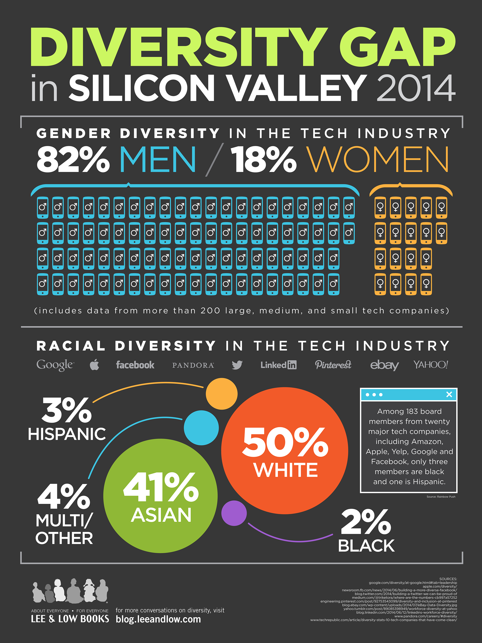
Works Cited
insert
insert
Notes:
https://blog.leeandlow.com/2015/03/12/the-diversity-gap-in-silicon-valley/

Slide 13

Thank you
Questions?

